Slide 1
Inaudible Sound as a Covert Channel in Mobile Devices
LiJiaYing

Slide 2
Outline
Motivation
Transmitter
Receiver

Slide 3
Motivation
Many of security do not consider inaudible sound as a method for
data exfiltration.
The method proprosed by the predecessors has no good anti

Slide 4


Transmitter
FSK
FSK‘s Signal can be represent as
So S(t) can decompose as

Slide 5





Transmitter
Input
modulation
sendBit
= sendBit*
bit stream
+
ReverseSendBit
= reverseSendbit*

Slide 6
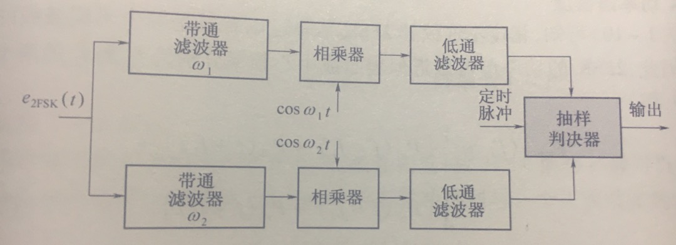
Receiver
Demodulation

Slide 7
Recevier
Use matlab for an experiment
sampleRate = 44100
Simulation Bits = 11011101001100101101
f1 = 19000
f2 = 18000

Slide 8
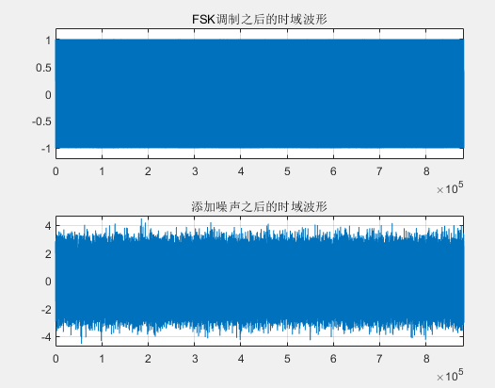
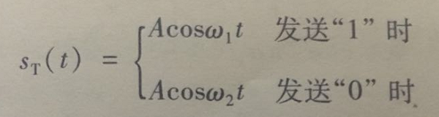
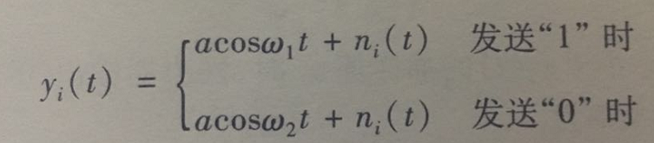
Receiver
The initial signal
Because the frequency is too large, the plot can't show the signal in details.

Slide 9
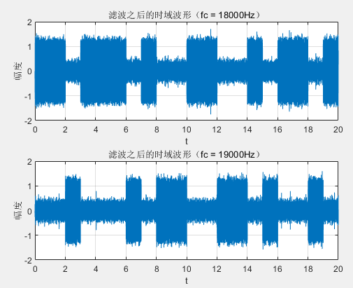
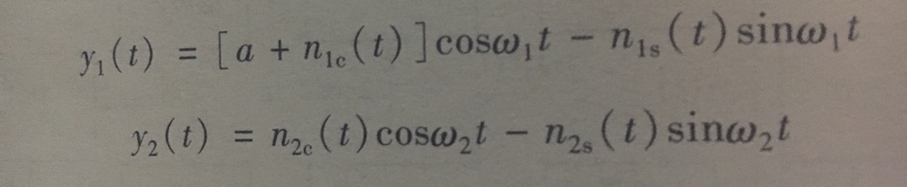
Receiver
Simulation Bits = 11011101001100101101
After a bandpass filter
Amuse send bit '1' in time (0,T)
Up and down two branch bandpass filter output waveforms:
up branch
down branch

Slide 10
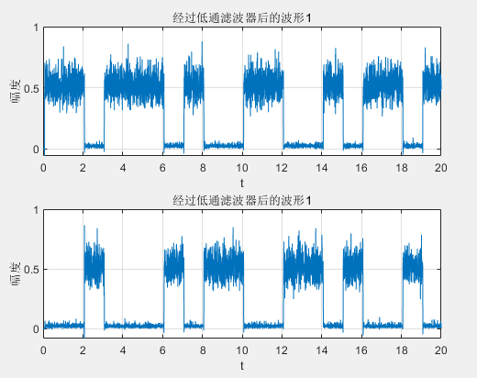

Receiver
Simulation Bits = 11011101001100101101
After a low pass filter
Amuse send bit '1' in time (0,T)
Up and down two branch low pass filter output waveforms:
up branch
down branch
we can judge the signal if X1(t) > X2(t) output bit '1'

Slide 11
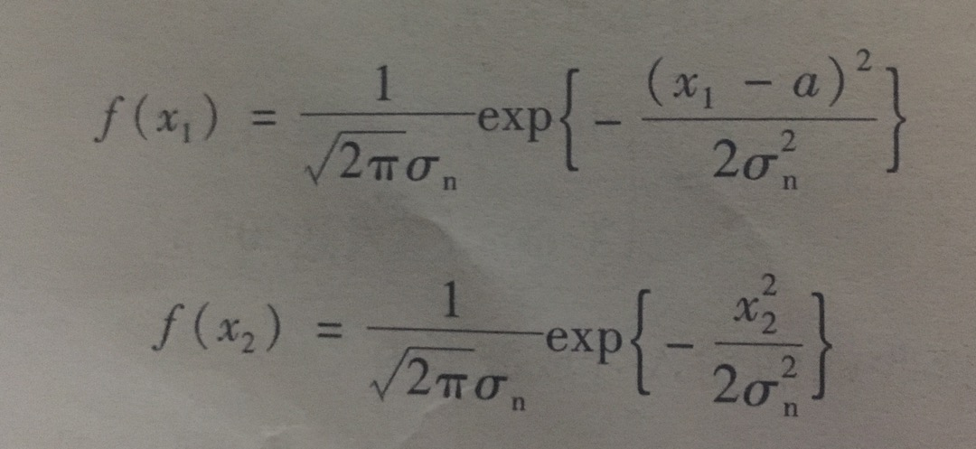
Receiver
The error rate
we can judge the signal if X1(t) > X2(t) output bit '1'
so when X1(t) <= X2(t) there is an error
probability density function

